Slide 1
first plots of arts lookup table
22.05.2024
Group meeting

Slide 2
Which fits did you do?
1 dimensional fits of absorption cross section at fixed frequency and temperature but with pressure dependance
Linear, quadratic and cubic fits done
res = sum of squared residuals as quality parameter and rmse = root means squared error
Studied O3 and CO2
At frequency of main absorption peaks and far away from it
Especially fitted log(cross section) with log(p)
Aim: get first idea which polynomial order you need at least for good polynomial parametrization
Notes:
After reading about evaluation of regressions I saw R2 is best, stil to add
For chosen frequencies refer to the first slide of last presentation

Slide 3
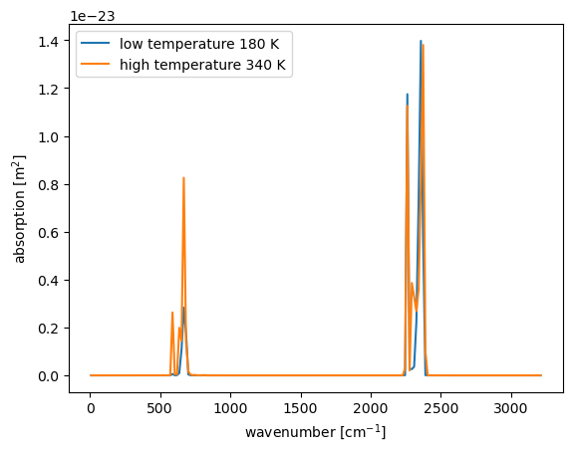
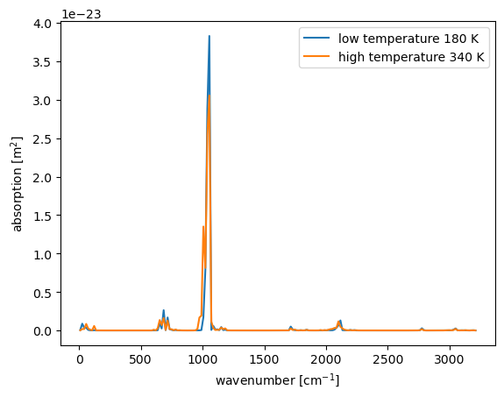
CO2 (left) and O3 (right) absorption
Notes:
Presure = 11000Pa for both

Slide 4
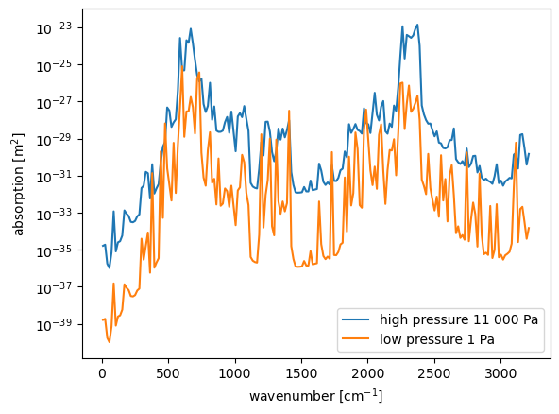
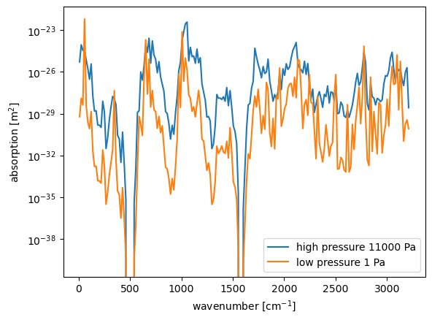
Pressure dependance of absorption-CO2 (l.) and O3 (r.)
⇒ better absorption at high pressures with some exceptions especially for ozone can be estimated (probably explained whether the random frequencies are laying at edge or peak of absorption line)
⇒ frequency dependent absorption
Notes:
temperature is high (10)th value which is (250 + 110) K = 360 K

Slide 5
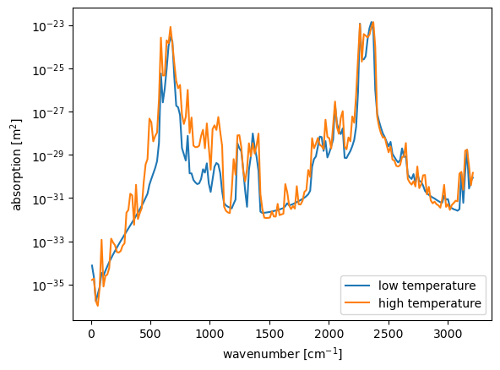
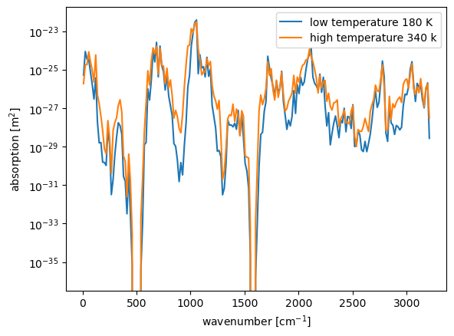
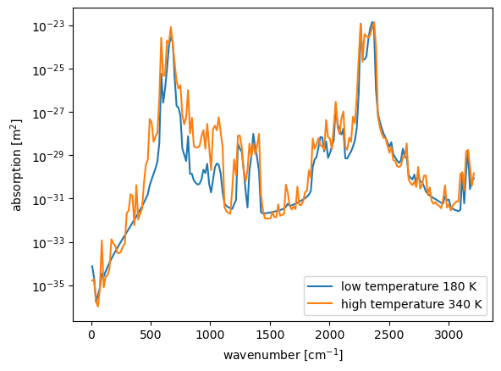
temperature dependance; absorption for CO2 (l.) and O3 (r.)
⇒ more and more intense absorption lines at high temperature can be estimated (explained probably mainly by hot bands)
Notes:
pressure = high pressure 11 000 Pa
hypothesis with hot bands must be verified theoretically and tested)

Slide 6
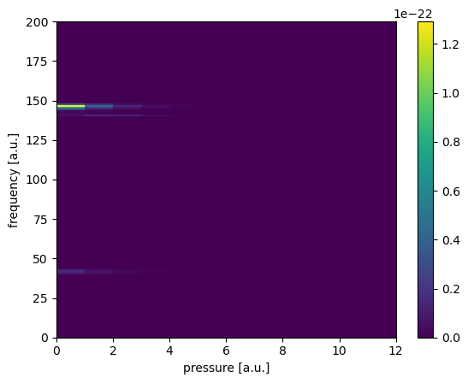
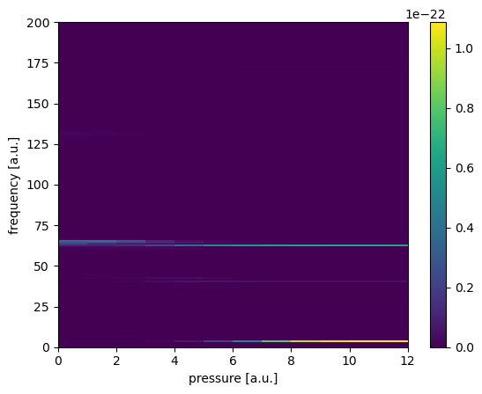
Frequency-pressure study of absorption-CO2 (l.) and O3 (r.)
⇒ ozone seems to invert the pressure dependance of absorption for some frequencies
⇒ at higher pressure, better absorption for CO2 and mostly O3 too
Notes:
the impression of inversion of absorption pressure dependance for ozone but not CO2 is probably a wrong impression and can be explained again, whether the absorption happens at a edge or peak frequency: in general both molecules should have the same absorption behaviour

Slide 7
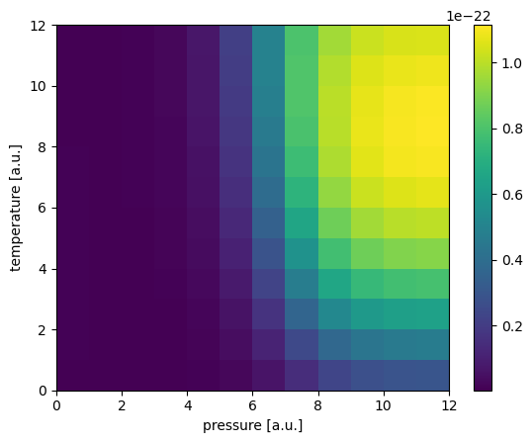
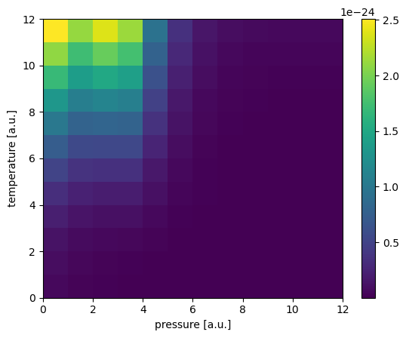
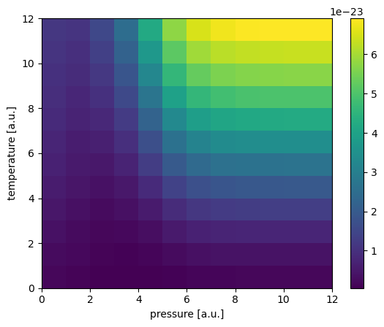
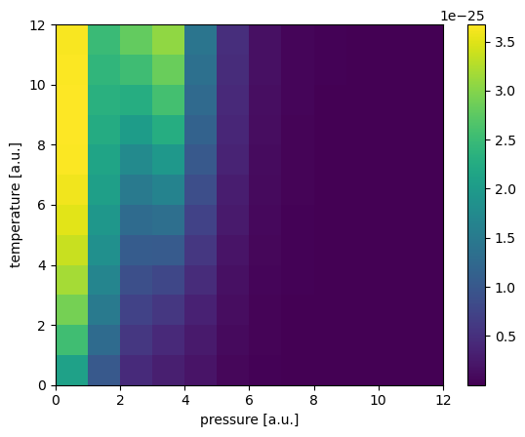
temperature-pressure absorption dependance for ozone
quite smooth functions, let estimate good preconditions for modeling with low order polynom
high P and and T better absorption
some local minima for 74 cm⁻¹ and 990 cm⁻¹
(58 (u.) and 74 (d.)) per cm
(990 (u.) and 1006 (d.)) per cm
Notes:
Quite smooth functions, let estimate good preconditions for modeling with low order poynom
Idea: develop ai algorithm for spotting local minima to see where low order polynoms don”t see the local minima maybe

Slide 8
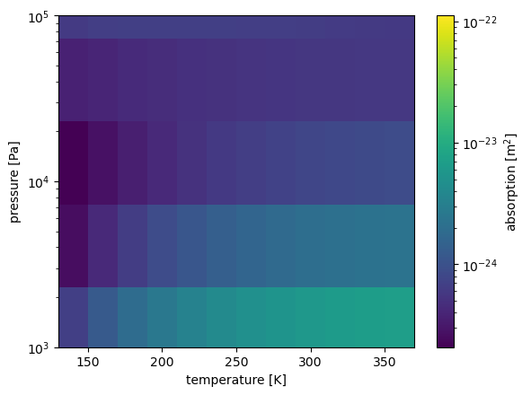
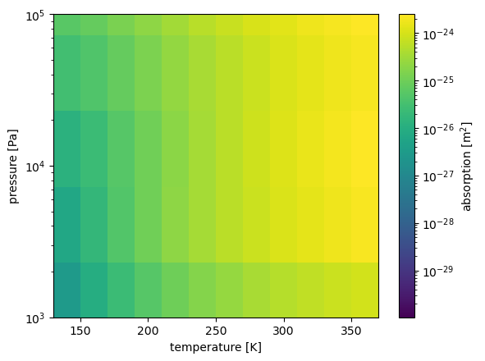
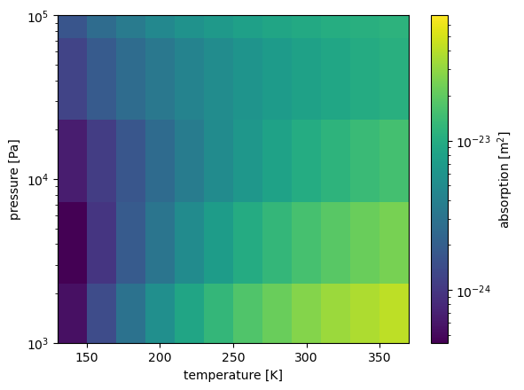
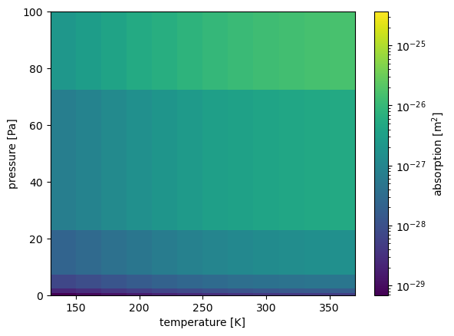
temperature-pressure absorption dependance for ozone
quite smooth functions, let estimate good preconditions for modeling with low order polynom
at high P and high T better absorption for (74 and 990) cm⁻¹
at small P and high T better absorption for (58 and 1006) cm⁻¹
(58 (u.) and 74 (d.)) per cm
(990 (u.) and 1006 (d.)) per cm
Notes:
Quite smooth functions, let estimate good preconditions for modeling with low order polynom
Idea: develop ai algorithm for spotting local minima to see where low order polynoms don”t see the local minima maybe
some local minima for 74 cm⁻¹ and 990 cm⁻¹ (only in the 12 times 12 block

Slide 9
First fits of arts lookuptable
1 dimensional linear fits of O3/CO2 athmosphere
Group meeting
26.06.24
Notes:
O2 and CO2 neglect second order effects like dependance of density and homogenously distributed

Slide 10
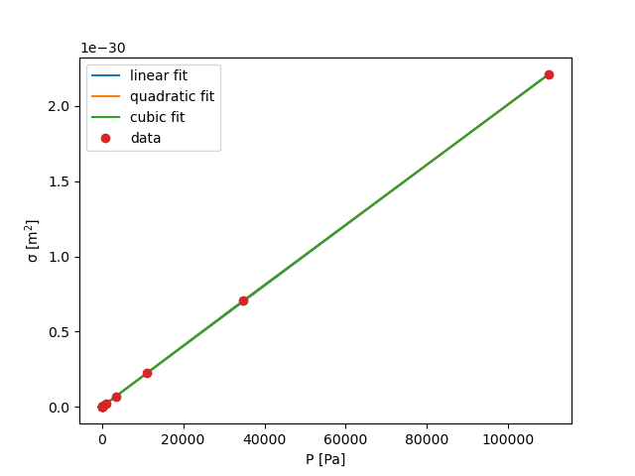
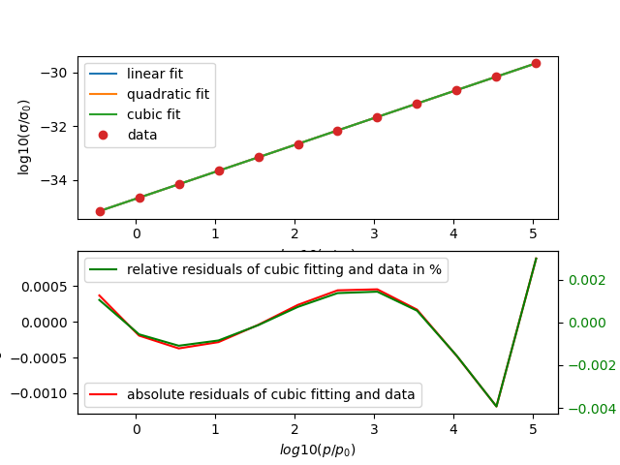
CO₂ far away from absorption peak
Frequency : 1003 cm⁻¹
Temperature: 240 K
Fitted abs. cross section
already linear fit sufficient
Frequency : 1003 cm⁻¹
Temperature: 240 K
Fitted log10(abs. cross section)
already linear fit sufficient
(res = 1.35 * 10^(-5))
(rmse = 0.00053 for 240 K
and rmse = 0.0023 for 360 K)
[%]
Notes:
Change axis description of non-log plot and zoom into
Can we explain the linear log(p) dependancy of the absorption sigma with the thermal occupation part and a low degree of degeneracy in the formula 9.16 (p.165) from the book Molekuelphysik und Quantenchemie
But this formula doesn”t contain the pressure dependance so far (important for width of absorption peak (maybe in rotational constant?)
Or exponential decreasing with pressure of Jevandjee paper?
We see a linear increasing cross section with p but with very small value near zero

Slide 11
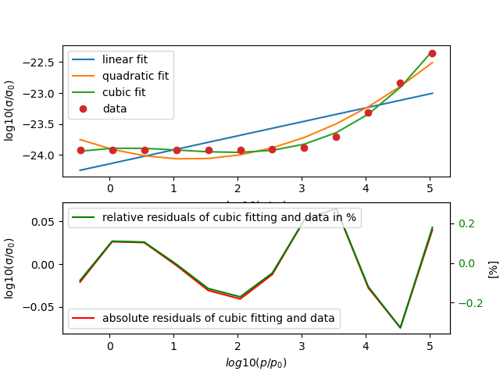
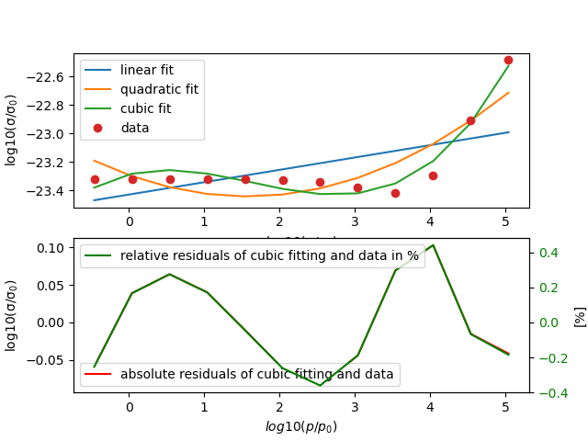
CO2 at main absorption peak (2340 cm⁻¹)
Temperature: 240 K (left) and 360 K (right)
linear and quadratic fit don”t match at all
Very good cubic fit for 240 K (res = 0.019 and rmse = 0.040)
Cubic fit in general good but also less precise than fits at other frequencies for 360 K (res = 0.041 and rmse = 0.058)
Notes:
Better absorption at higher temperatures

Slide 12
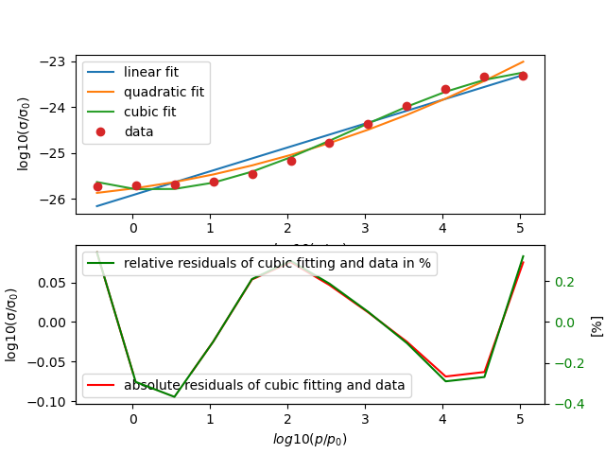
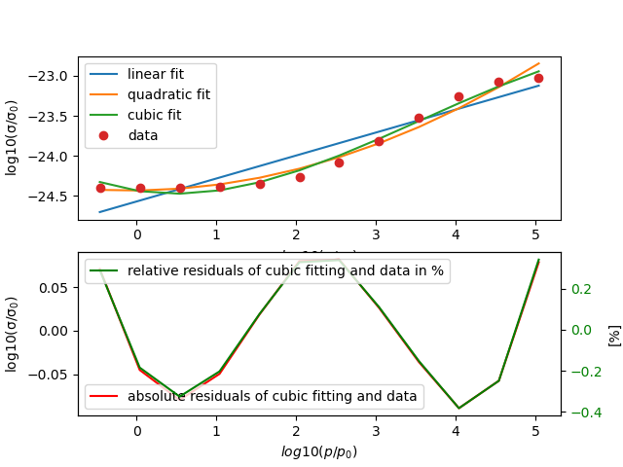
Ozone main absorption peak
frequency: 1003 cm⁻¹
Temperature: 240 K (left) and 360 K (right)
not well matching linear and quadratic fit
good cubic fits (for 240 K: res = 0.049, rmse = 0.064 )
(for 360 K: res = 0.048 and rmse = 0.064)
Notes:
Idea especially pressure broadening can be described by a polynomial fit, other effects worse describable (but probably wromg because absolute and relative residual are staying more or less the same

Slide 13
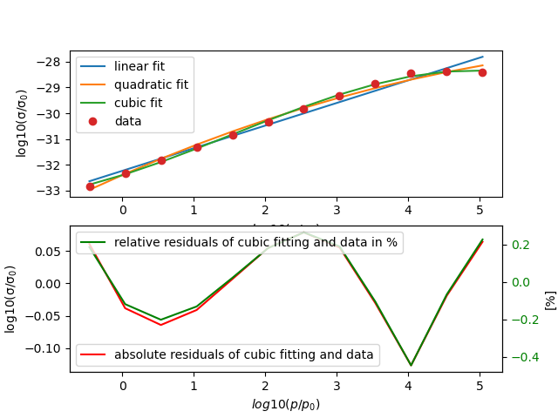
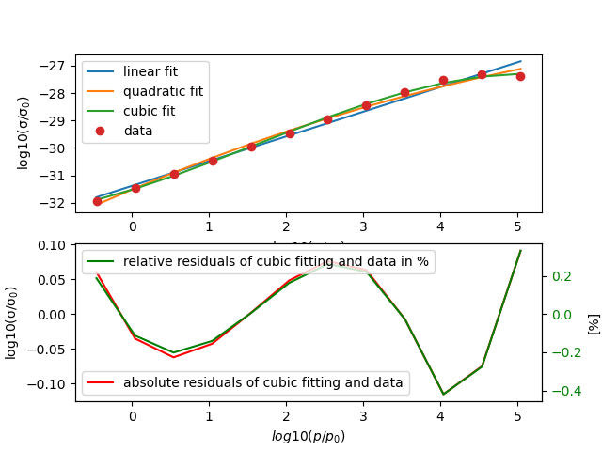
Ozone far away from absorption peak
Frequency: 295 cm⁻¹
Temperature: 240 K and 360 K
in general, good but not sufficient linear and quadratic fit
Flattening at higher pressure only fitted well by cubic fit
for 240K: res = 0.0448 and rmse = 0.236
for 360K: res = 0.05 and rmse = 0.204

Slide 14
Table with all so far done 1 dim fits
 | gas | v [cm⁻¹] | T [K] | linear fit good? (res) | quad. fit good? (res) | cubic fit good? (res) | absortion peak?
 | CO₂ | 102 (point6) | 240 | 4.8 * 10⁻⁶(excellent) | 2.7 * 10⁻⁶(excellent) | 1.2 * 10⁻⁶ (excellent) | no absorption peak
 | CO₂ | 102 (point6) | 360 | 5.7 * 10⁻⁵(excellent) | 3.26 * 10⁻⁵(excellent) | 1.48 * 10⁻⁵(excellent) | no absorption peak
 | CO₂ | 649 (point40) | 240 | 0.332 (quite good) | 0.111 (good) | 0.019 (very good) | main absorption peak
 | CO₂ | 649 (point40) | 360 | 0.457 (quite good) | 0.276 (good) | 0.031 (very god) | main absorption peak
 | CO₂ | 1003(point 62) | 240 | 1.35 * 10⁻⁵(excellent) | 7.51* 10⁻⁶ (excellent) | 3.29* 10⁻⁶ (excellent) | no absorption peak
 | CO₂ | 1003(point 62) | 360 | 0.0003 (very good) | 0.0001 (very good) | 6.2 * 10⁻⁵(excellent) | no absorption peak
 | CO₂ | 2340(point 145) | 240 | 1.166 (very bad) | 0.186 (good) | 0.019 (good) | main absorption peak
 | CO₂ | 2340 (point 145) | 360 | 0.517 (bad) | 0.21 (bad) | 0.041 (good) | main absorption peak
 | O₃ | 102 (point6) | 240 | 0.634 (not good) | 0.142 (good) | 0.015 (good) | no absorption peak
 | O₃ | 102 (point6) | 360 | 0.897 (not good) | 0.179 (good) | 0.0096 (excellent) | no absorption peak
 | O₃ | 295(point 18) | 240 | 0.675 (bad) | 0.236 (bad) | 0.0448 (quite good) | no absorption peak
 | O₃ | 295(point 18) | 360 | 0.507 (bad) | 0.204 (quite good) | 0.05 (quite good) | no absorption peak
 | O₃ | 1003(point 62) | 240 | 0.646 (bad) | 0.313 (quite good) | 0.049 (good especially high P) | main absorption peak
 | O₃ | 1003(point 62) | 360 | 0.398 (bad) | 0.094 (good) | 0.048 (good) | main absorption peak

Slide 15
Table with all so far done 1 dim fits
gas | v [cm⁻¹] | T [K] | linear fit good? (res) | quad. fit good? (res) | cubic fit good? (res) | cubic fit good rmse | maximal residual | minimal residual | absortion peak?
CO₂ | 102 (point6) | 240 | 4.8 * 10⁻⁶(excellent) | 2.7 * 10⁻⁶(excellent) | 1.2 * 10⁻⁶ (excellent) |  |  |  | no absorption peak
CO₂ | 102 (point6) | 360 | 5.7 * 10⁻⁵(excellent) | 3.26 * 10⁻⁵(excellent) | 1.48 * 10⁻⁵(excellent) |  |  |  | no absorption peak
CO₂ | 649 (point40) | 240 | 0.332 (quite good) | 0.111 (good) | 0.019 (very good) | 0.040 | 0.005 (0.021%) | (-0.082) (0.347%) | main absorption peak
CO₂ | 649 (point40) | 360 | 0.457 (quite good) | 0.276 (good) | 0.031 (very god) | 0.050 | (-0.003) | (-0.097) | main absorption peak
CO₂ | 1003(point 62) | 240 | 1.35 * 10⁻⁵(excellent) | 7.51* 10⁻⁶ (excellent) | 3.29* 10⁻⁶ (excellent) | 0.00052 | (-4.31 * 10⁻⁵ ) (-0.0013%) | (-0.00012) (-0.0039%) | no absorption peak
CO₂ | 1003(point 62) | 360 | 0.0003 (very good) | 0.0001 (very good) | 6.2 * 10⁻⁵(excellent) | 0.0023 | (-0.00017) (-0.00053%) | (-0.0050) (0.01736) | no absorption peak
CO₂ | 2340(point 145) | 240 | 1.166 (very bad) | 0.186 (good) | 0.019 (good) | 0.040 | (-0.0013) (-0.0056%) | (0.0746) (0.3296) | main absorption peak
CO₂ | 2340 (point 145) | 360 | 0.517 (bad) | 0.21 (bad) | 0.041 (good) | 0.058 | (-0.0101)(-0.0432%) | 0.01029 (0.4419%) | main absorption peak
O₃ | 102 (point6) | 240 | 0.634 (not good) | 0.142 (good) | 0.015 (good) |  |  |  | no absorption peak
O₃ | 102 (point6) | 360 | 0.897 (not good) | 0.179 (good) | 0.0096 (excellent) |  |  |  | no absorption peak
O₃ | 295(point 18) | 240 | 0.675 (bad) | 0.236 (bad) | 0.0448 (quite good) | 0.0611 | 0.00657 (0.0213%) | (-0.12676) (-0.4457%) | no absorption peak
O₃ | 295(point 18) | 360 | 0.507 (bad) | 0.204 (quite good) | 0.05 (quite good) | 0.0645 | 0.0012 (0.0042%) | (-0.11552) (-0.4198%) | no absorption peak
O₃ | 1003(point 62) | 240 | 0.646 (bad) | 0.313 (quite good) | 0.049 (good especially high P) | 0.064 | 0.0121 (0.0499%) | (-0.0943)(-0.3669%) | main absorption peak
O₃ | 1003(point 62) | 360 | 0.398 (bad) | 0.094 (good) | 0.048 (good) | 0.064 | 0.01858 (0.0763%) | (-0.0887) (-0.3815%) | main absorption peak

Slide 16
Main results and following estimations
In general, polynomial fitting of log10(cross section) with log10(p/p0) seems a well applicable approach.
Fitting order must be at least 3rd order
Fit seem to match better at higher presure (maybe only pressure broadening well described by polynomial function?)
Fits seem to match better often already linear at small absorption than at absorption peak
Notes:
Maybe: For CO2 fits seem to match better at low temperatures e.g. for 2340 cm⁻¹

Slide 17
Further steps
Develop good standardisation for quality estimation of fit and average deviation
Make fit with higher order polynoms
Think about physical justification of the polynomial fitting in 1 dimensional
Take more or less sample points and evaluate fit quality
Notes:
Split up in training and data set

Slide 18
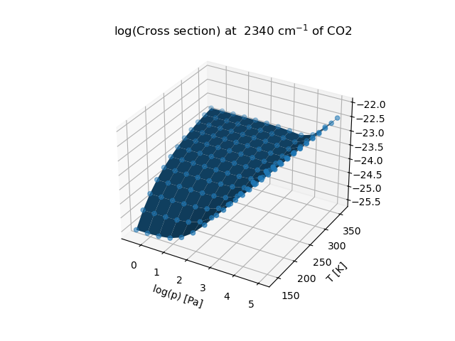
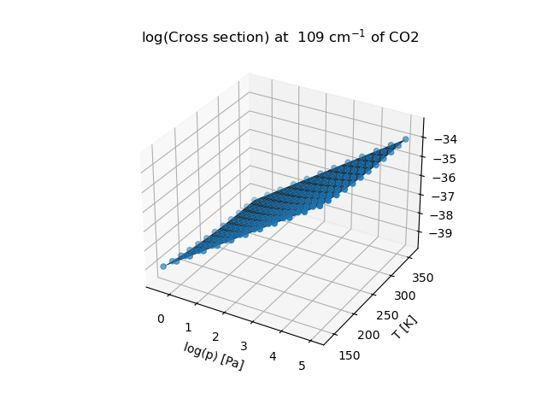
First 3 dimensional plots
plotted the log(p) and T dependance of the log(cross section)
Better optical visualization and estimation of smoothness or not smoothness than with the color plot
Notes:
Question save the plot with the rotating possibility later

Slide 19
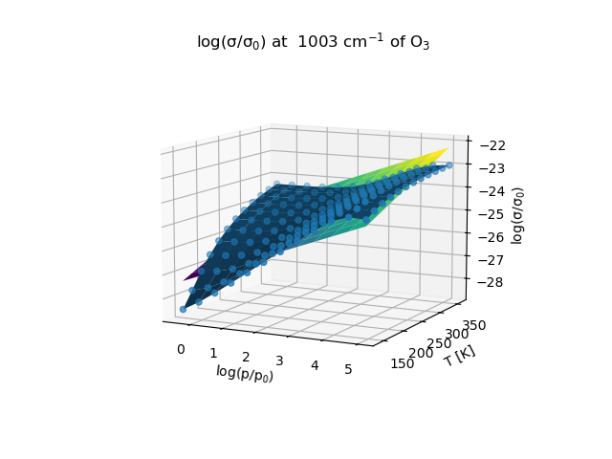
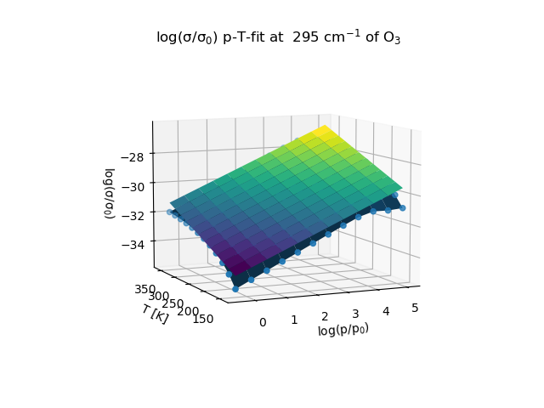
First 2 dimensional linear fits (ozone)
2 dimensional linear p-T fit of log(cross section) at one absorption peak (left) and far away from absorption peak (right)
Notes:
Seems to be more linear (far away from absorption peak) (explian physically missing)

Slide 20
Summary and to do now
Developed the basis for 1 and 2 dimensional fitting
Study now more strategically the fitting conditions/ also with R² values
Go to higher polynomials
Get good physical justification of the fits
Especially write a general polynomial parametrization with general quality indicator
Notes:
Further to do split in training and fitting set and see when overfitting starts

Slide 21
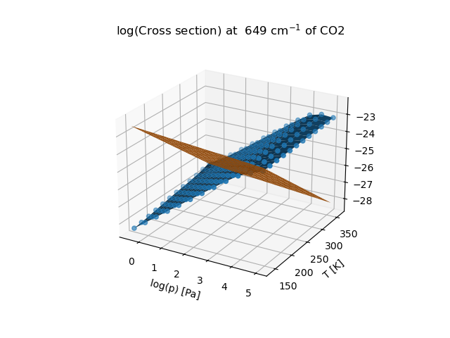
Try out linear fitting of 2 dim function
Notes:
Question save the plot with the rotating possibility later question:
What can be the mistake of my fit?

Slide 22
1 dimensional fitting
Group meeting 10.07.2024

Slide 23
Different functions of cross section to fit
So far always fitted ln(cross section) with ln(p)
Now fitted cross section with p directly
Also tried out sigmoid, sigma/p,
Studied also microwave and optical frequencies and in general more frequencies

Slide 24
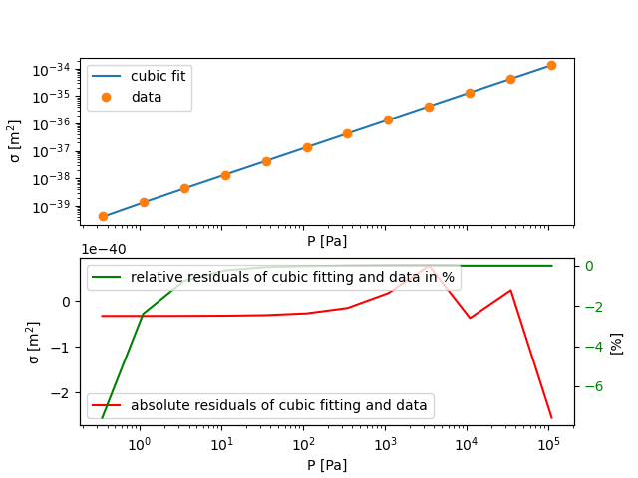
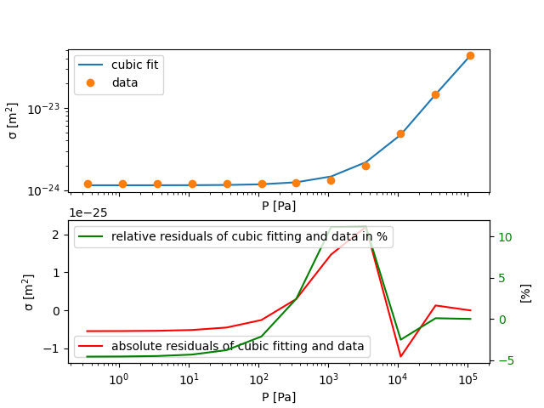
Fit cross section with pressure directly
CO2 at 109 cm⁻¹ at 240 K far away from absorption peaks (left)
Fitted cross section with cubic polynom with the pressure dependane for both
R² = 0.999999999995
But large relative deviation for ultralow pressures
CO₂ at 2340 cm⁻¹ at 240K at absorption peak (right)
R² =0.9994
Midfrequencies difficult to fit
Notes:
The large deviation for small pressures is here much larger than in the ln(sigme) function and fit

Slide 25
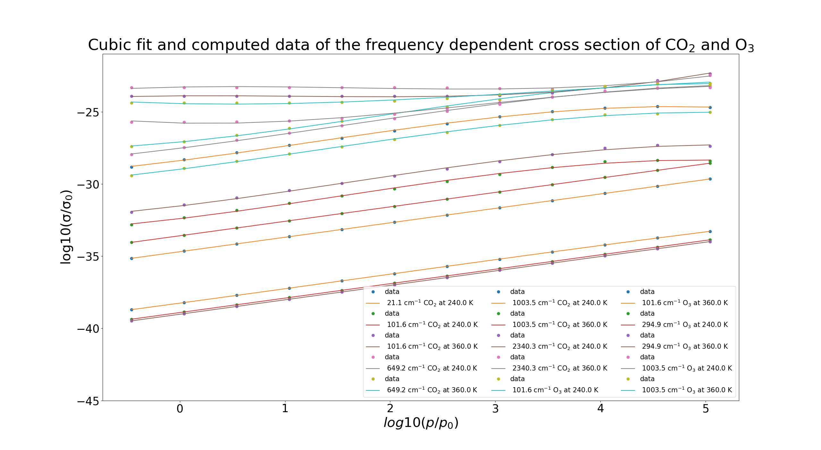
Cumulative plot: cross sections data and fit
Computation of ln(cross section)
Cubic fiting
For CO₂ and O₃
Different behaviour at peak wings and far away from absorption peak

Slide 26
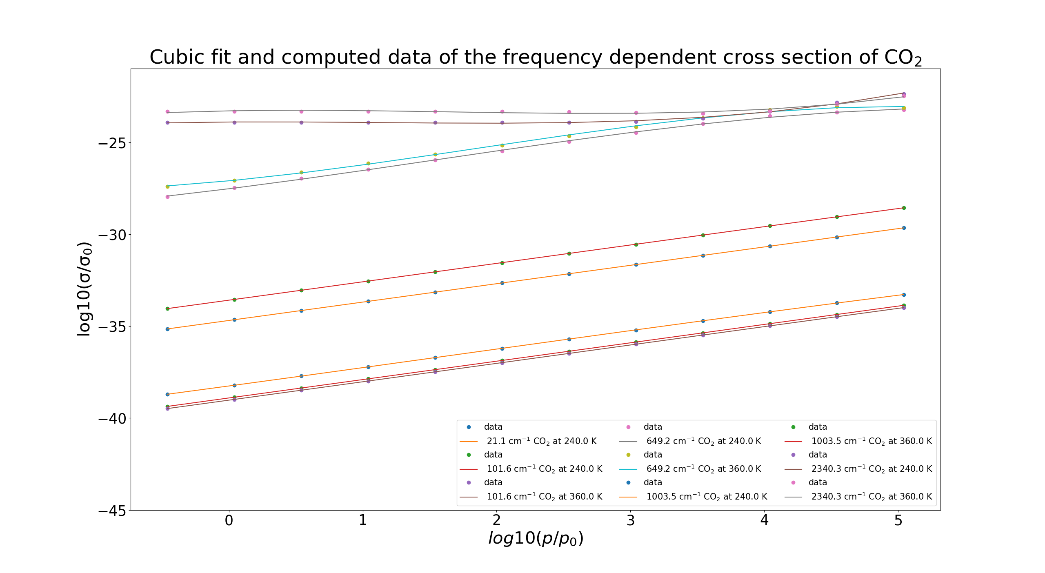
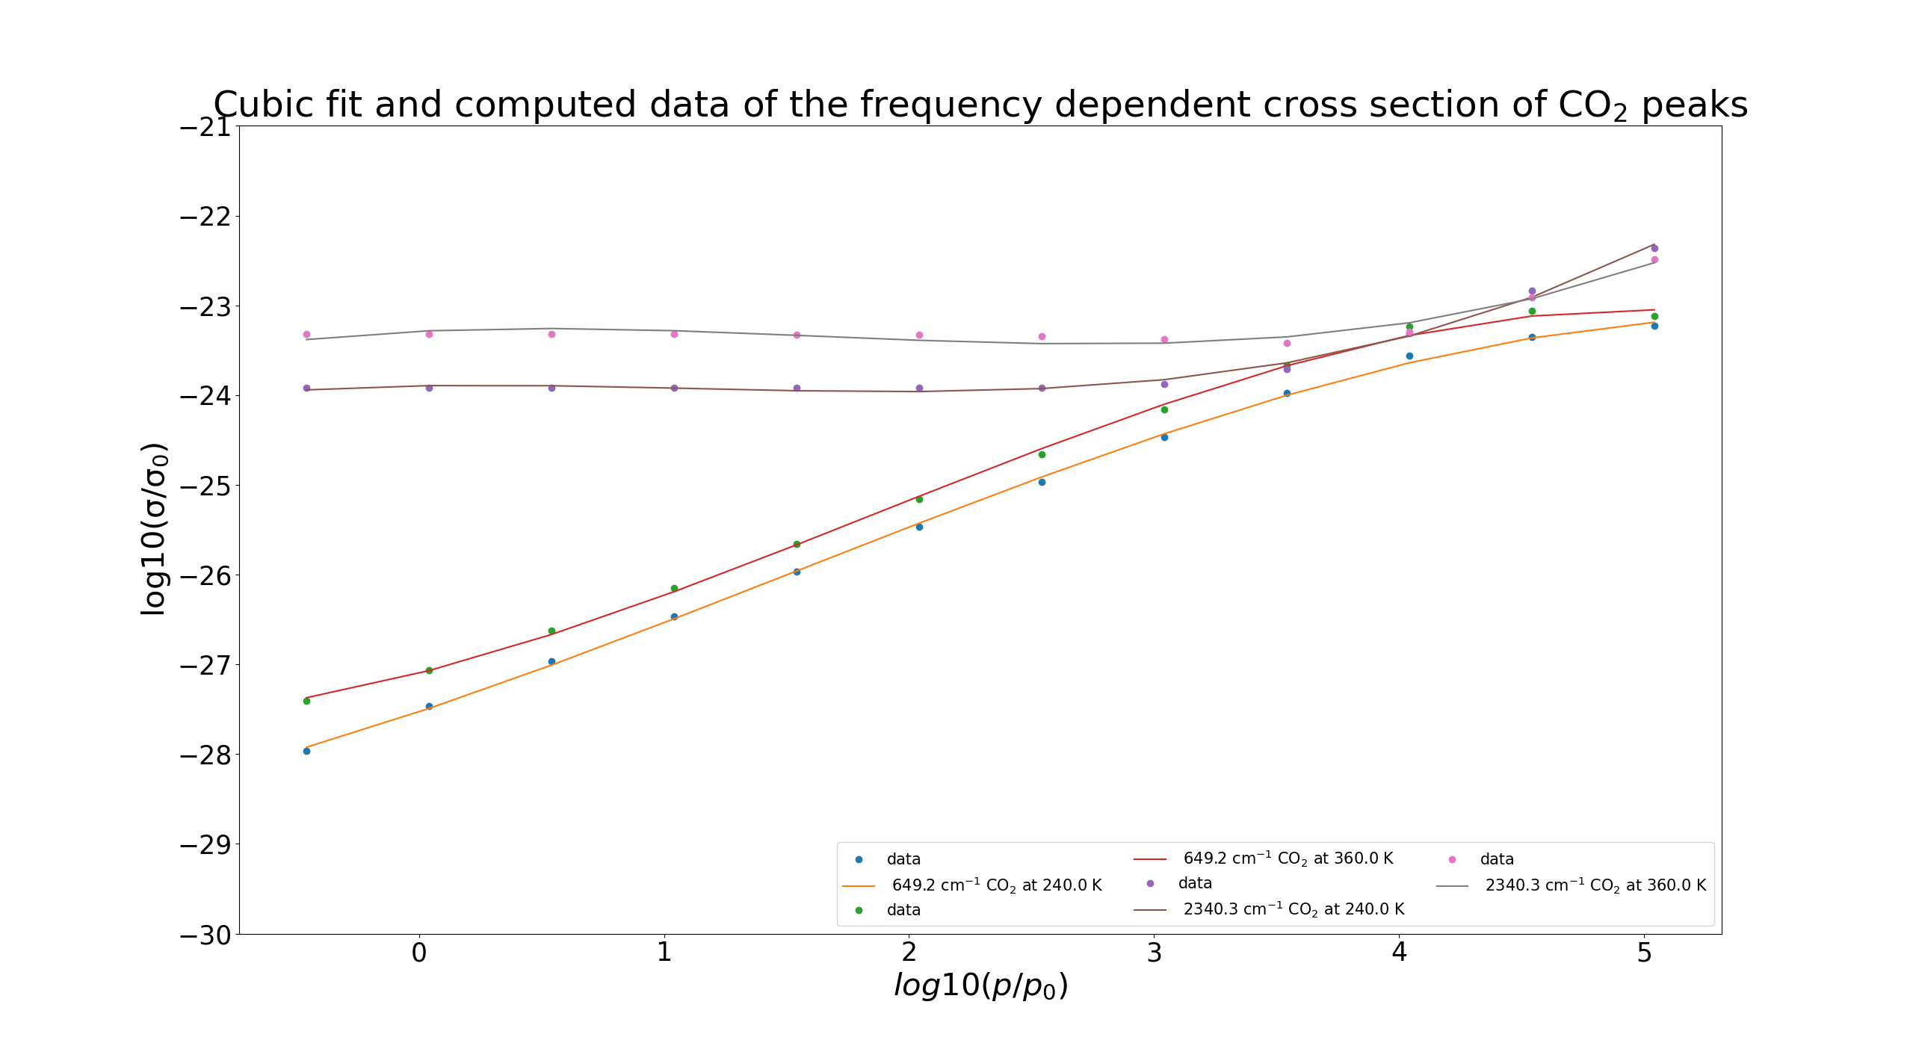
Cumulative plot: cross sections data and fit for CO₂
Same computation and cubic fit only for CO2
Picture below zoom into behaviour at absorptions peaks
Notes:
649 cm^(-1) and 2340 cm^(-1) are main absorption peaks
Higher temperature better absorption
Hypothesis: Does it come from stronger Doppler broadening but T is also included in formula for more dominant pressure broadening

Slide 27
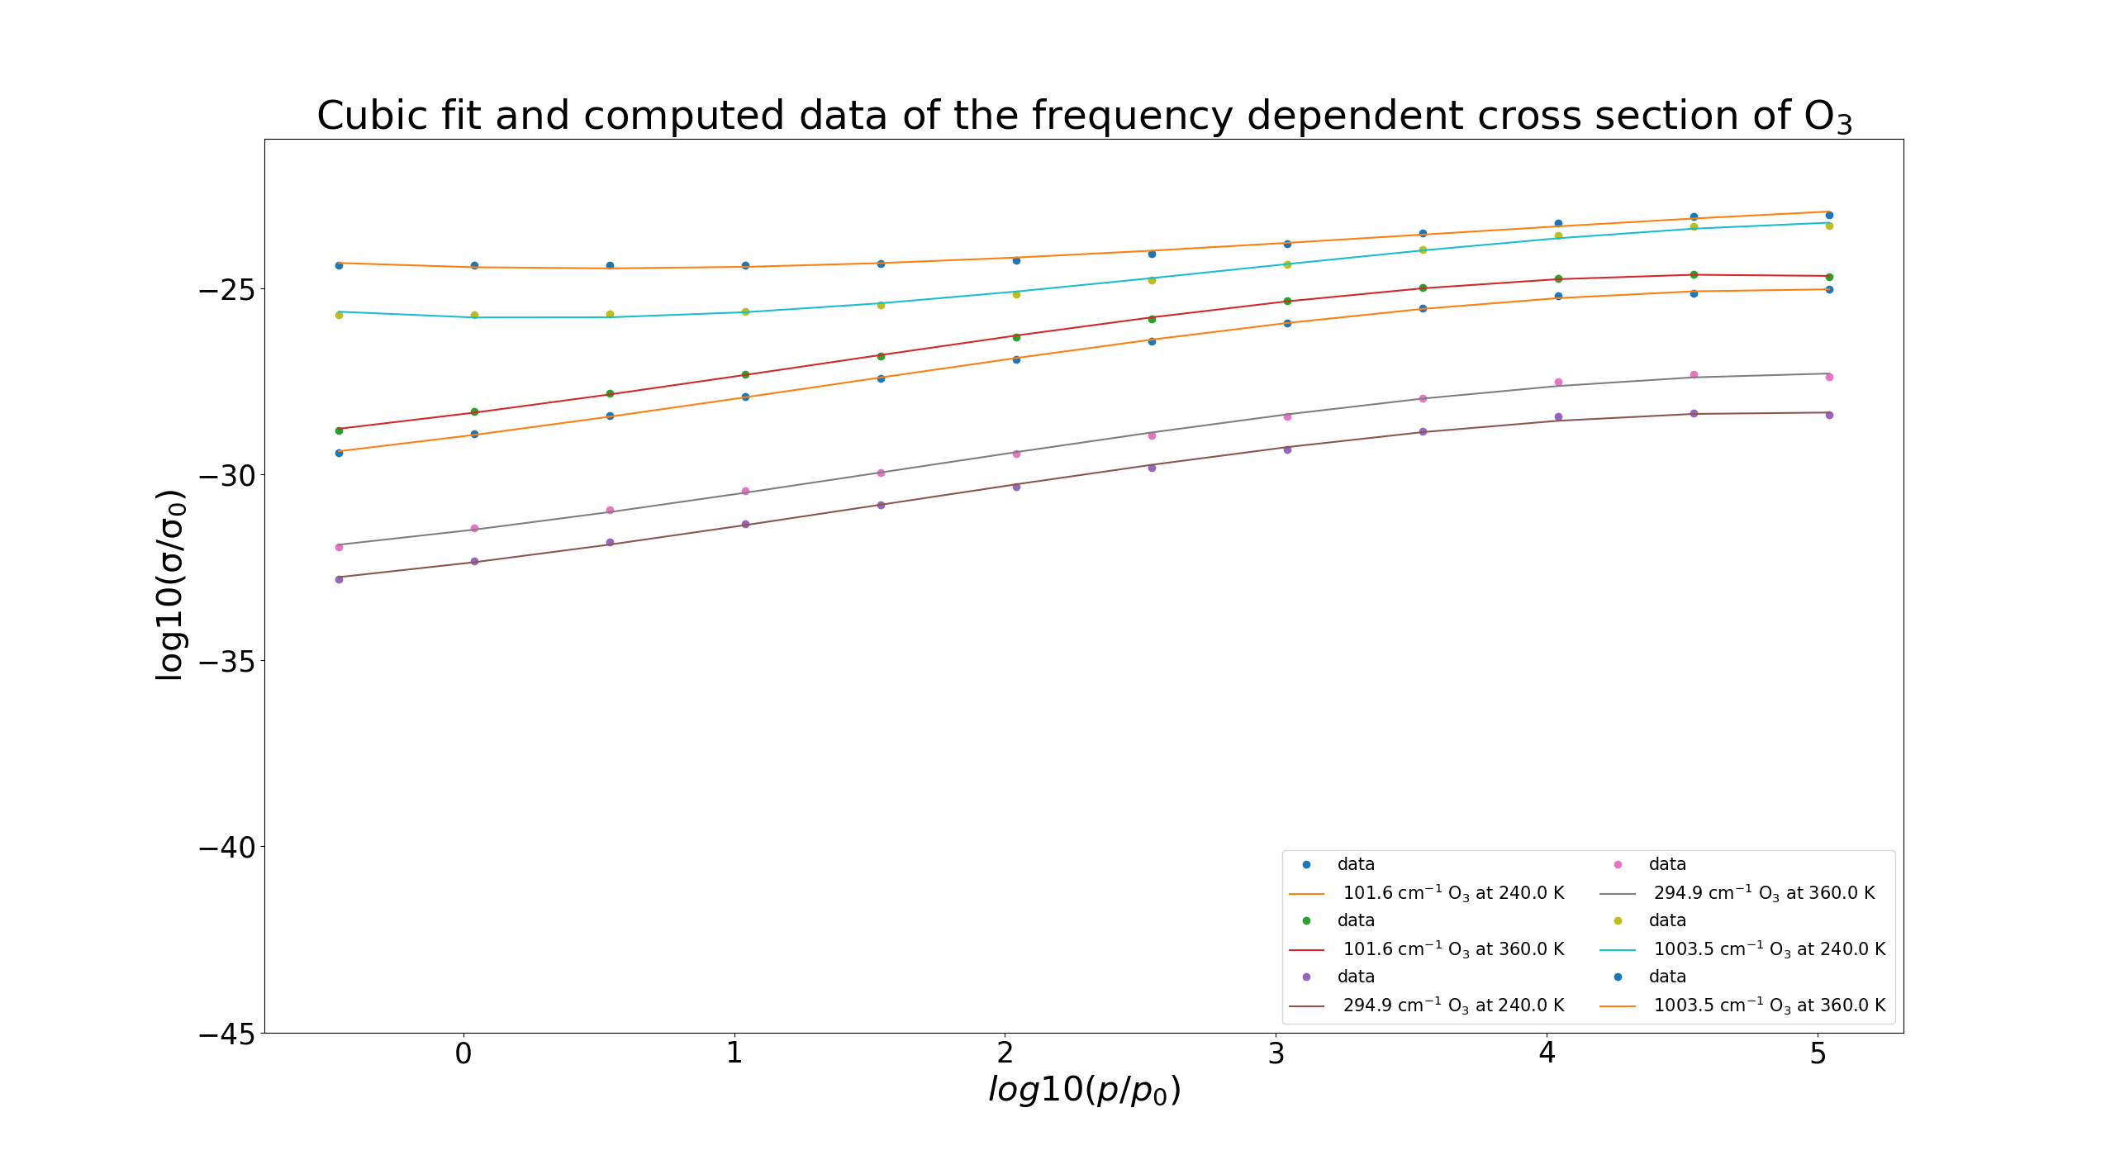
Cumulative plot: cross sections data and fit for O₃
Cubic fit of P-dependent O₃ cros sections
Less linear far away from peak than for CO₂
Notes:
Only 1003 cm^(-1) is an absorption peak of Ozone
First wrong idea: non linearity comes from Doppler et higher frequencies for ozone, but wrong because we see it already for lower frequencies

Slide 28
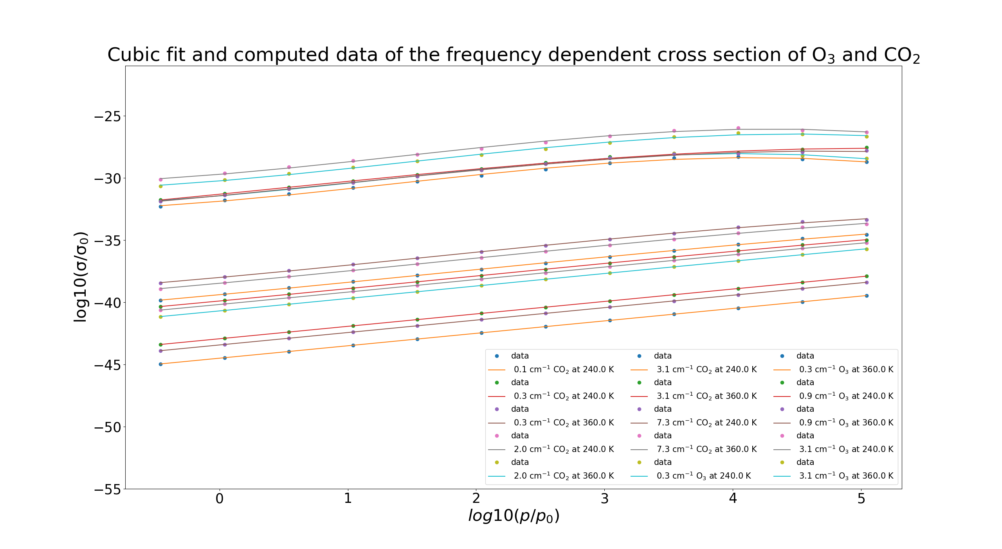
Cumulative plot: cross sections data and fit (microwave)
in general much weaker absorption in the microwave range
But general p dependency similar to infrared

Slide 29
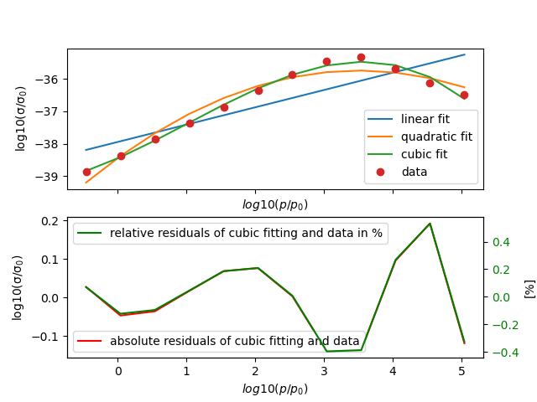
Absorption Peak in the microwave interval (CO₂)
Absorption peak at 0.75 cm⁻¹ at 240 K for CO₂
Similar fit quality as for peaks in infrared interval

Slide 30
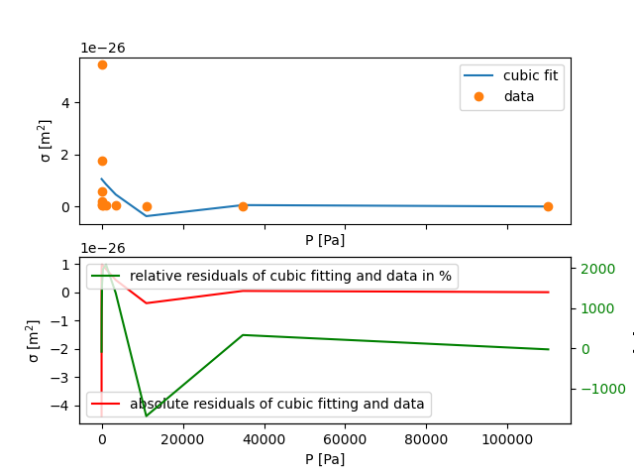
Try out sigma/p cubic fitting of cross section
1003 cm⁻¹ for O3 at 240 K
Cubic fiting doesn’t approximate at all
very large deviations

Slide 31
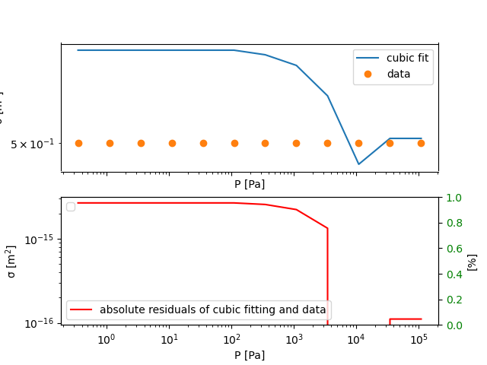
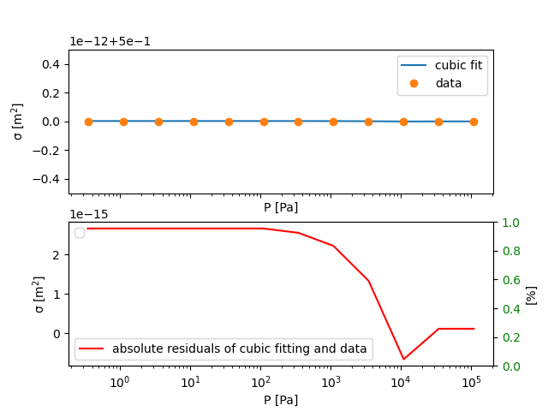
Try cubic fitting of sigmoid of cross section
1003 cm⁻¹ for O3 at 240 K
Cubic fiting doesn’t approximate at all it seems first
misleading impression: very small deviations between data and fit
Plot seems wrong but no implementation error found
Notes:
Fit computes 5. 000 000 000 0027

